Slide 1
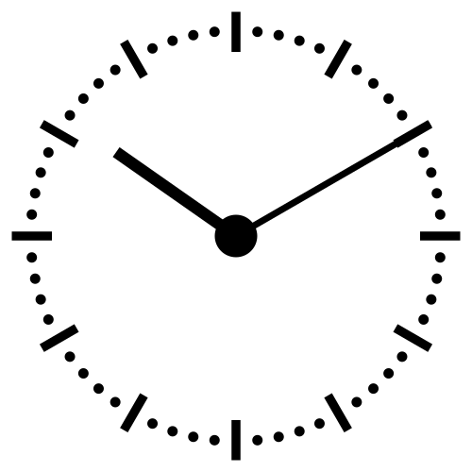
The Fourth Hour!
Welcome to…

Slide 2
Introduction
Welcome to the Fourth Hour!
Name
Professor
A fun fact about you

Slide 3
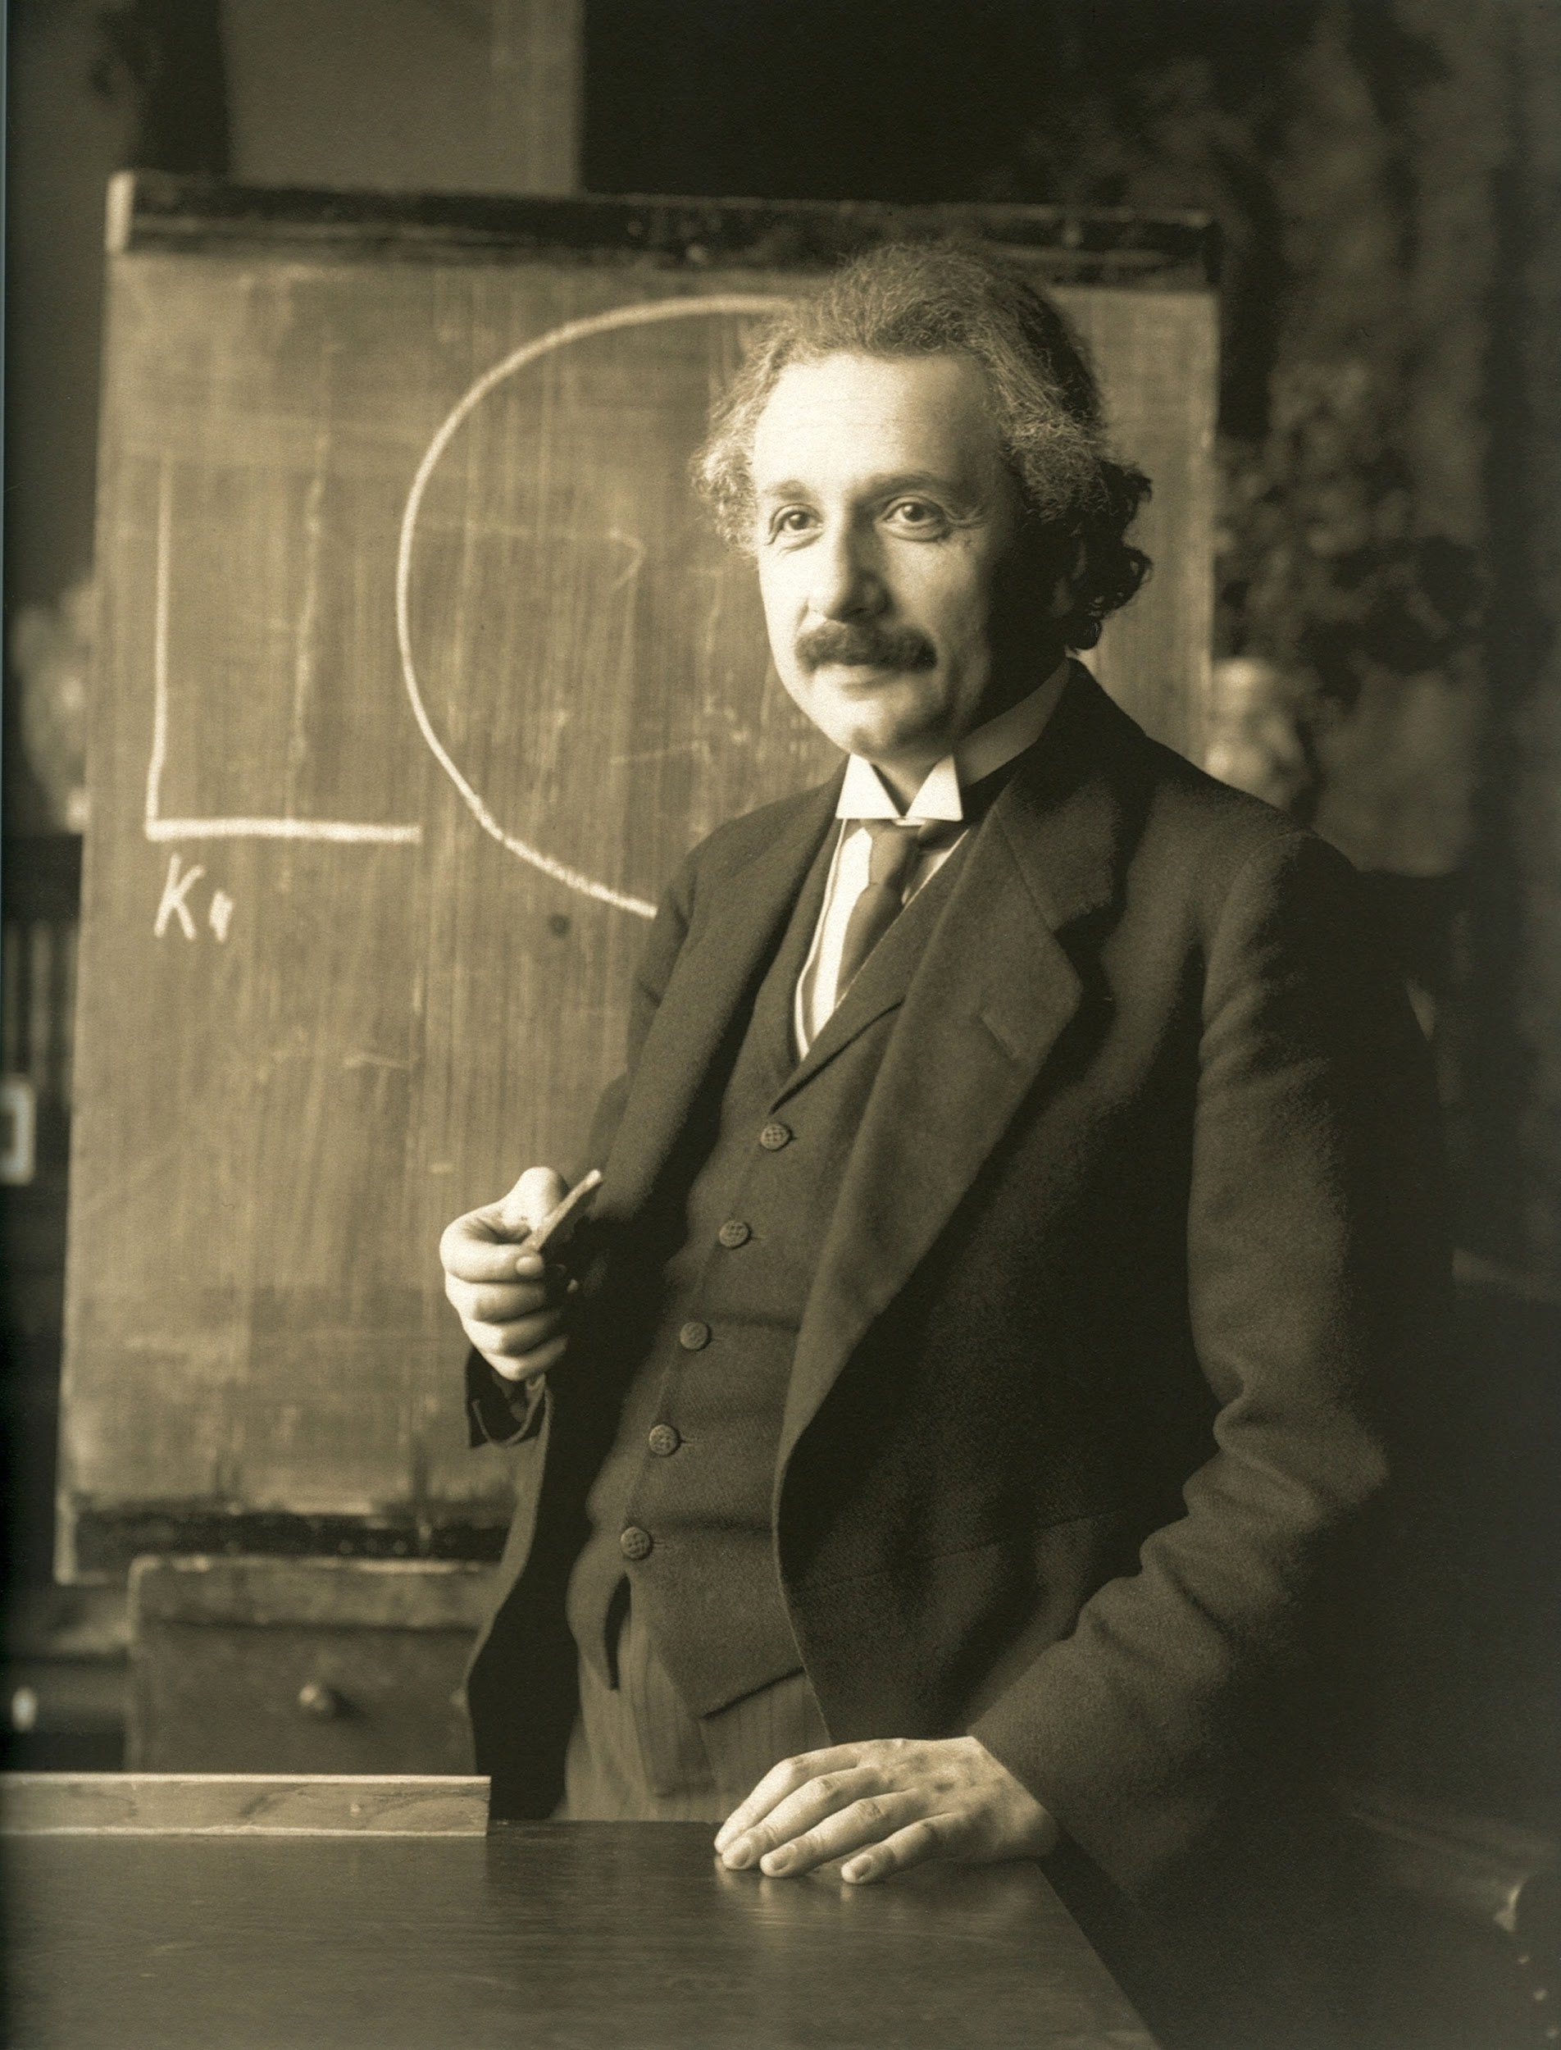
“Anyone who has never made a mistake has never tried anything new.”

Slide 4
What are loops
Loops allow us to perform the same action or similar action over and over again while a certain condition is met.
What kind of loops have we learned so far?
while loop

Slide 5
while loops
i = 0
while i < 3: print i
i += 1

Slide 6
while loops
Initial value (initializer)
i = 0
while i < 3: print i
i += 1

Slide 7
while loops
Initial value (initializer)
i = 0
while i < 3: print i
i += 1
Condition that must be met

Slide 8
while loops
Initial value (initializer)
i = 0
while i < 3: print i
i += 1
Condition that must be met
Update

Slide 9
Review
Login to Socrative at https://b.socrative.com/login/student/
Use code 4thHour149

Slide 10
Question 1 - PI
What is printed by the following code?
x = 6
while x > 4:
print(x, end=” ”)
x = x - 1
6 5
6 5 4
5 4
5 4 3
6 5 4 3

Slide 11
Question 1 - PI
What is printed by the following code?
x = 6
while x > 4:
print(x, end=” ”)
x = x - 1
6 5
6 5 4
5 4
5 4 3
6 5 4 3

Slide 12
Practice 1
Use a while loop to print every odd number 1-10.
Output should be:
1
3
5
7
9
Notes:
i = 1
while i <= 10:
print(i)
i += 2

Slide 13
Practice 2
Write a program that calculates the factorial for a number using a while loop.
5 factorial is 120 → 5 * 4 * 3 * 2 * 1
Notes:
start = 5 # this can be any num
i = 1
temp = 1
while i <= start:
temp *= i
i += 1
print(start, "factorial is", temp)

Slide 14
Practice 3
Using while loop combined with an if statement, iterate through the given list and if there is a 100, print it with its index number.
i.e.: "There is a 100 at index no: 3"
lst=[10, 1, 5, 100, 4]
Notes:
lst=[10, 1, 5, 100, 4]
i = 0
while i < len(lst):
if lst[i] == 100:
print("There is a 100 at index no: " + str(i))
i = i+1

Slide 15
Question 2
What is printed by the following code?
x = 6
while x > 4:
x = x - 1
print(x, end=” ”)
6 5
6 5 4
5 4
5 4 3
6 5 4 3

Slide 16
Question 2
What is printed by the following code?
x = 6
while x > 4:
x = x - 1
print(x, end=” ”)
6 5
6 5 4
5 4
5 4 3
6 5 4 3

Slide 17
Practice 4
Using while loop and an if statement write a function that appends all the elements in a list to a new list unless the element is an empty string: "".
For example:
lst =["Carter", "Maddie", "", "Cory", "", "", "", "Alyssa"]
should print:
['Carter', 'Maddie', 'Cory', 'Alyssa']
Notes:
lst =["Carter", "Maddie", "", "Cory", "", "", "", "Alyssa"]
i = 0
new_list = []
while i < len(lst):
if lst[i] != "":
new_list.append(lst[i])
i += 1
print(new_list)

Slide 18
Practice 5
Using a while loop and if statement, count how many times a letter is in a word
For example:
word = “Hello”
letter = “l”
Should print:
2
Notes:
word = "hello"
letter = "l"
i = 0
count = 0
while i < len(word):
if word[i] == letter:
count += 1
i += 1
print(count)

Slide 19
Question 3 - PI
What is printed by the following code?
n = 3
while n > 0:
if n == 5:
n = -99
print(n, end=” ”)
n = n + 1
3 4
3 4 5
3 4 -99
3 4 5 -99

Slide 20
Question 3 - PI
What is printed by the following code?
n = 3
while n > 0:
if n == 5:
n = -99
print(n, end=” ”)
n = n + 1
3 4
3 4 5
3 4 -99
3 4 5 -99

